Slide 1
Investigating Tissue Importance for Diagnosis of Post-Traumatic Elbow Disease
Washington University in St. Louis
Tillman James
Topics in Statistics: Machine Learning
December 7th, 2022

Slide 2
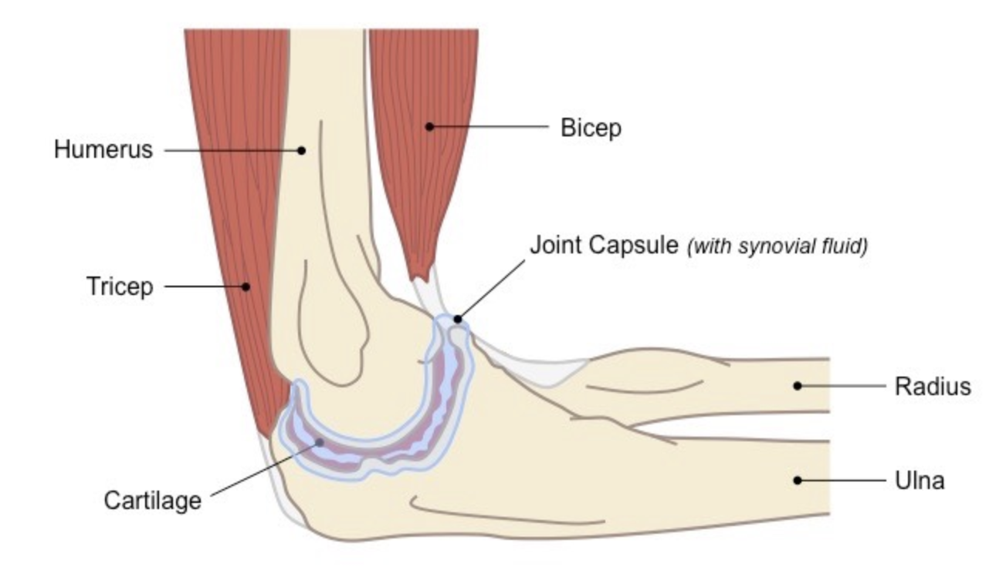
Motivation: Tissues of the Joint Capsule is Directly Affected by Post Traumatic Joint Contracture (PTJC)
PTJC is a disease of the elbow
Caused from dislocations, fractures, and ligament tears
Capsule tissue main driver of PTJC
MRI is used to detect pathological changes in elbow capsule
Research suggest cellular changes within the tissue of Joint Capsule
https://ib.bioninja.com.au/higher-level/topic-11-animal-physiology/112-movement/joints.html

Slide 3
Motivation: Which of the 30 Types of Tissue are Most Important in the Joint Capsule?
High Resolution MRI Scan
Segmented Joint Capsule
Tissue Types of Joint Capsule

Slide 4
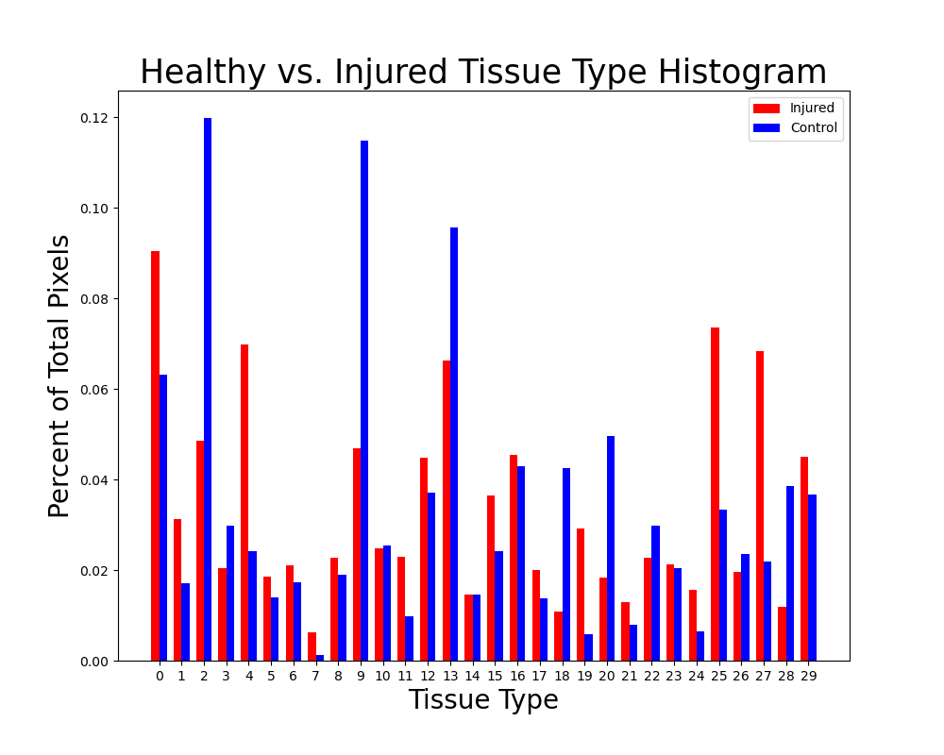
Background: Healthy vs. Injured Tissues Distributions are Different

Slide 5
Data: Tissue Type are Features Used to Make Classification
611 Images - 409 Training and 202 Testing
Training – 107 Healthy , 302 Injured
Testing – 46 Healthy, 156 Injured

Slide 6
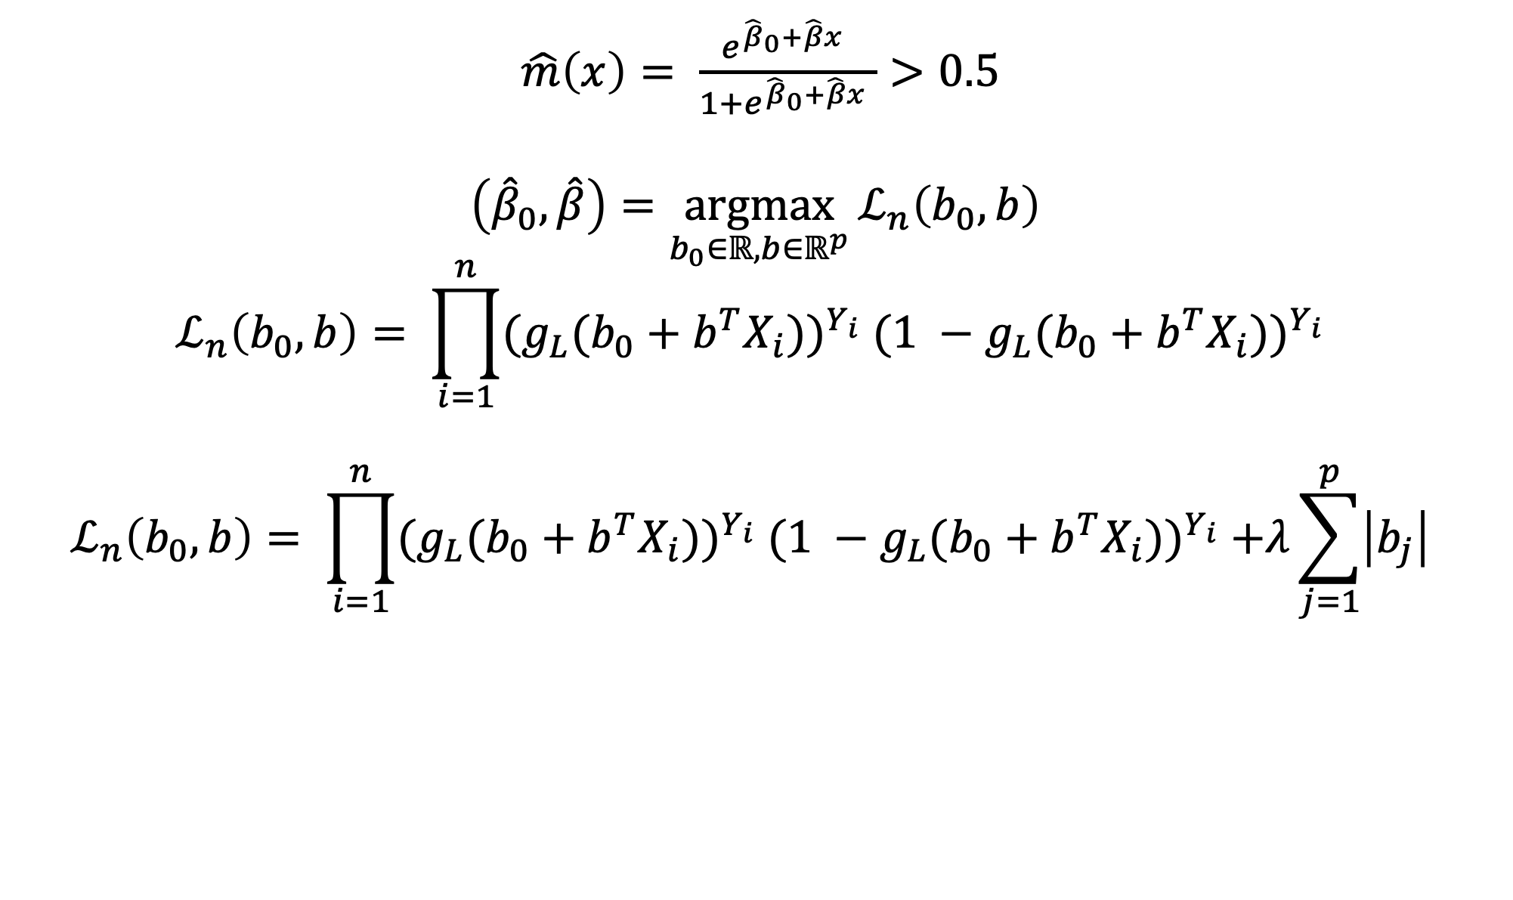
Most Important Features are Found using Logistic Regression
$\hat{m}\left(x\right)= \frac{e^{{\hat{β}}_{0}+\hat{β}x} }{1+e^{{\hat{β}}_{0}+\hat{β}x} }>0.5$
$$\left({\hat{β}}_{0},\hat{β}\right)=\underset{b_{0}∈ℝ, b∈ℝ^{p}}{argmax}{ℒ_{n}\left(b_{0},b\right)}$$
$$ℒ_{n}\left(b_{0},b\right)= \prod_{i=1}^{n}{{{(g}_{L}(b_{0}+b^{T}X_{i}))}^{Y_{i}} {(1 −g_{L}(b_{0}+b^{T}X_{i}))}^{Y_{i}} }$$
$$ℒ_{n}\left(b_{0},b\right)= \prod_{i=1}^{n}{{{(g}_{L}(b_{0}+b^{T}X_{i}))}^{Y_{i}} {(1 −g_{L}(b_{0}+b^{T}X_{i}))}^{Y_{i}} +λ\sum_{j=1}^{p}{\left|b_{j}\right|} }$$

Slide 7
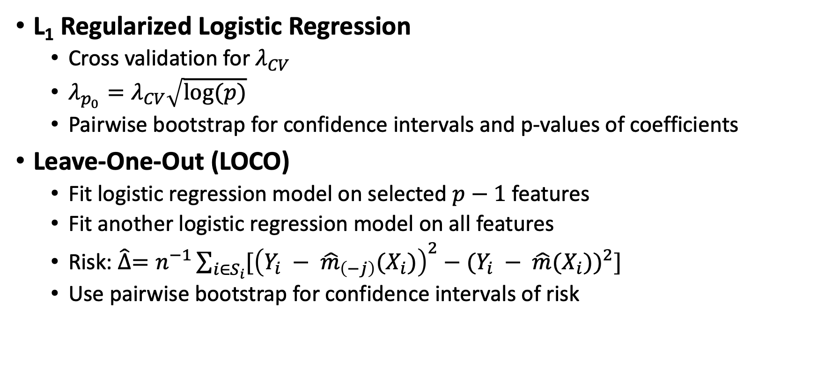
Statistical Methods can be used to Find Relative Tissue Importance
L₁ Regularized Logistic Regression
Cross validation for $λ_{CV}$
$λ_{p_{0}}=λ_{CV}\sqrt{log⁡(p)}$
Pairwise bootstrap for confidence intervals and p-values of coefficients
Leave-One-Out (LOCO)
Fit logistic regression model on selected $p−1$ features
Fit another logistic regression model on all features
Risk: $\hat{∆}=n^{−1}\sum_{i∈S_{i}}{[{\left(Y_{i} − {\hat{m}}_{\left(−j\right)}(X_{i})\right)}^{2}−{(Y_{i} − \hat{m}(X_{i}))}^{2}]}$
Use pairwise bootstrap for confidence intervals of risk

Slide 8
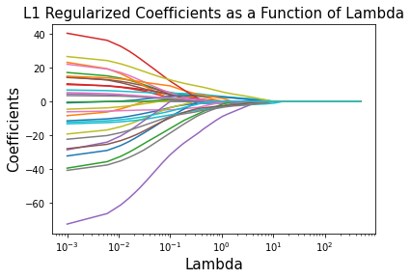
L₁ Regularized Feature Importance Results

Slide 9

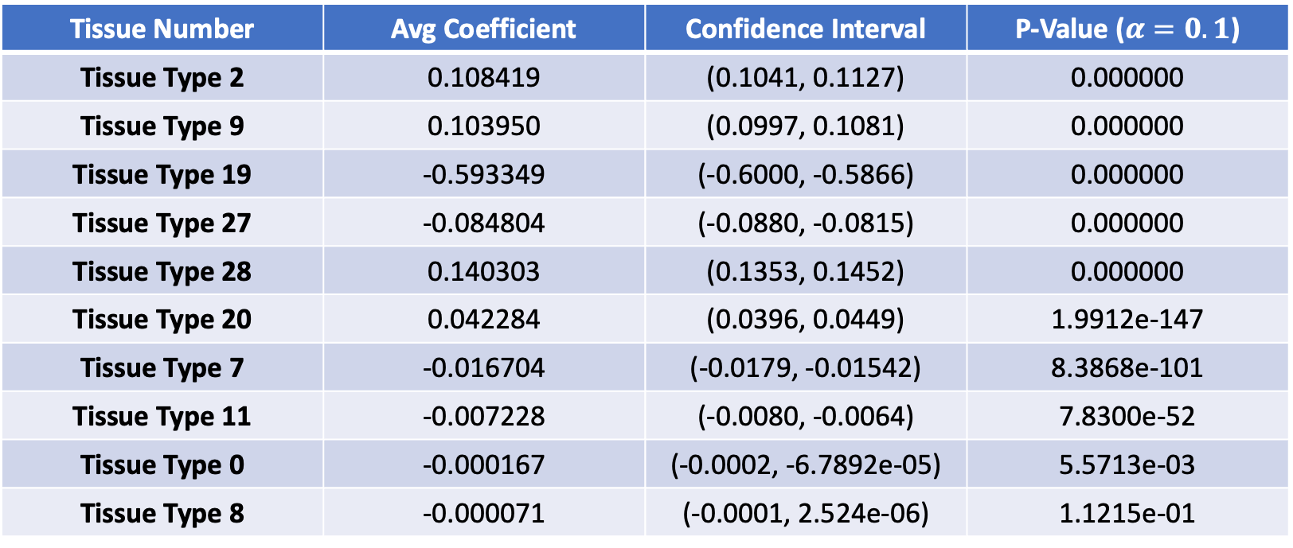
L₁ Regularized Cross Validation Feature Importance Results
$$λ_{CV}=\text{5.76494}$$
Tissue Number | Avg Coefficient | Confidence Interval | P-Value ($α=0.1$)
Tissue Type 2 | 0.108419 | (0.1041, 0.1127) | 0.000000
Tissue Type 9 | 0.103950 | (0.0997, 0.1081) | 0.000000
Tissue Type 19 | -0.593349 | (-0.6000, -0.5866) | 0.000000
Tissue Type 27 | -0.084804 | (-0.0880, -0.0815) | 0.000000
Tissue Type 28 | 0.140303 | (0.1353, 0.1452) | 0.000000
Tissue Type 20 | 0.042284 | (0.0396, 0.0449) | 1.9912e-147
Tissue Type 7 | -0.016704 | (-0.0179, -0.01542) | 8.3868e-101
Tissue Type 11 | -0.007228 | (-0.0080, -0.0064) | 7.8300e-52
Tissue Type 0 | -0.000167 | (-0.0002, -6.7892e-05) | 5.5713e-03
Tissue Type 8 | -0.000071 | (-0.0001, 2.524e-06) | 1.1215e-01
Notes:
-5-Fold CV to find Lambda_CV
-Then ran pairwise bootstrap for 10000 iterations to find avg coefficients, CI, and p-values to guage actual importance

Slide 10
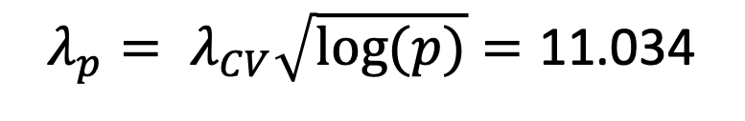
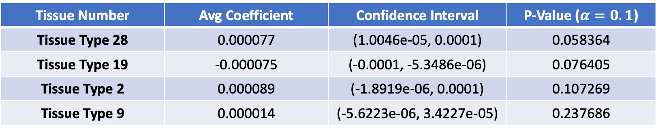
L₁ Regularized Empirical Feature Importance Results
$${λ_{p}= λ}_{CV}\sqrt{log⁡(p)}=\text{11.034}$$
Tissue Number | Avg Coefficient | Confidence Interval | P-Value ($α=0.1$)
Tissue Type 28 | 0.000077 | (1.0046e-05, 0.0001) | 0.058364
Tissue Type 19 | -0.000075 | (-0.0001, -5.3486e-06) | 0.076405
Tissue Type 2 | 0.000089 | (-1.8919e-06, 0.0001) | 0.107269
Tissue Type 9 | 0.000014 | (-5.6223e-06, 3.4227e-05) | 0.237686
Tissue Number | OLS Coefficient
Tissue Type 28 | 2.8848
Tissue Type 19 | -3.6633
Tissue Type 2 | 1.7349
Tissue Type 9 | 2.0976
Notes:
Did 10000 iteration bootstrap to find avg coefficient, CI, p-values for importance
After finding 4 most important features, then re-ran logistic regression with no regularization to get cofficients

Slide 11
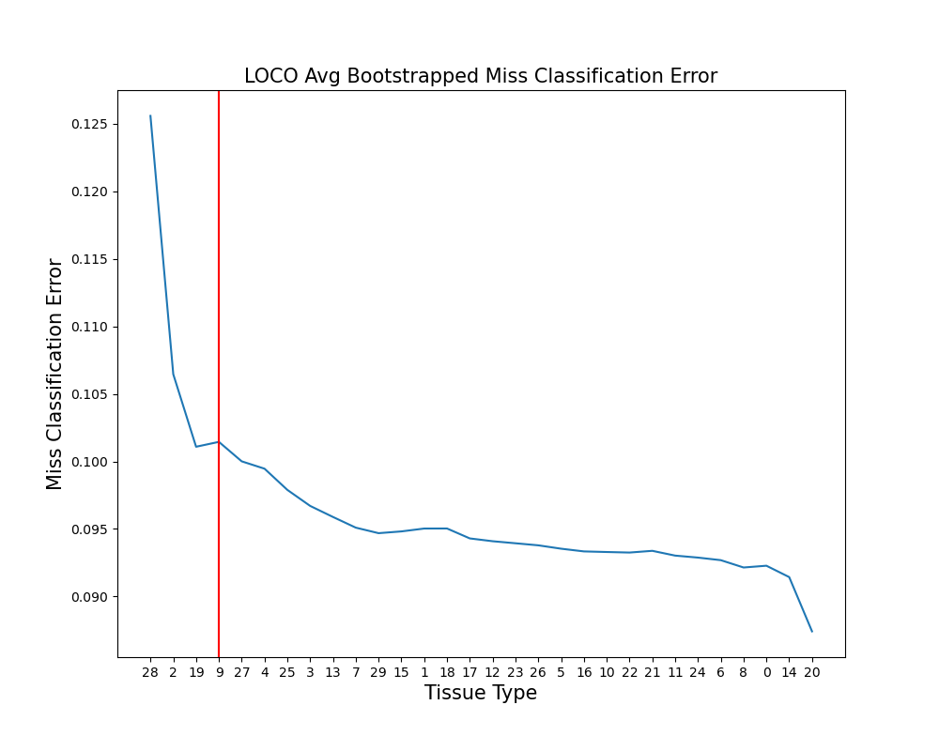
LOCO Feature Importance Results
Tissue Number | Avg Risk | Confidence Interval
Tissue Type 28 | 0.030741 | (0.0298, 0.0315)
Tissue Type 2 | 0.012785 | (0.0122, 0.0133)
Tissue Type 19 | 0.008156 | (0.0076, 0.0086)
Tissue Type 9 | 0.007267 | (0.0067, 0.0078)
Tissue Type 27 | 0.006067 | (0.0056, 0.0065)
Tissue Type 4 | 0.005807 | (0.0054, 0.0061)
Tissue Type 25 | 0.003741 | (0.0033, 0.0040)
Tissue Type 3 | 0.002941 | (0.0026, 0.0032)
Tissue Type 13 | 0.001874 | (0.0016, 0.0021)
Tissue Type 15 | 0.001326 | (0.0010, 0.0015)
Notes:
Add MSE plot to show how to find best total number of features

Slide 12
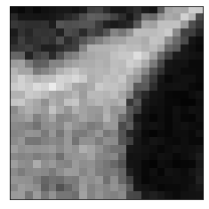
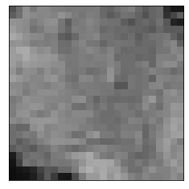
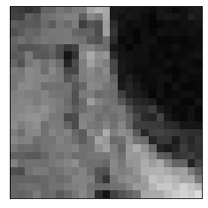
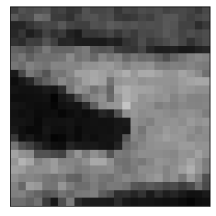
Tissue Types 28, 19, 9, and 2 are Most Important for PTJC Disease Classification
Tissue Type 19
Tissue Type 2
Tissue Type 28
Tissue Type 9

Slide 13
Classification Results with Final Tissue
Method | Miss-Classification Error | Accuracy
All Features | 0.094 | 0.906
L₁ Logistic Regression | 0.144 | 0.856
LOCO | 0.109 | 0.891

Slide 14
Thank You!

